Slide 1
London-Paris-Compare

Slide 2
Introduction and Business Problem
London and Paris are two of the most ancient city in the world. This project is aim to try to analysis the two cities, more specifically I aimed to analysis how the cities can be separated to several section(cluster) with similar shops and facilities. By doing so, I believe we can have betting understanding of the two cities.
The Reason for choosing London and Paris is because both cities have a lot of data available to the public and make it very easy to collect data for both of the cities.

Slide 3
Data Description
London:
I get the data from https://en.wikipedia.org/wiki/List_of_London_boroughs
The dataframe contain data of London consist:
1. Borough : Name of Borough
2. Latitude : Latitude
3. Longitude : Longitude
Paris
I get the data from https://en.wikipedia.org/wiki/Arrondissements_of_Paris and from https://www.data.gouv.fr/fr/datasets/r/e88c6fda-1d09-42a0-a069-606d3259114e.
I preprocess the data into a cvs file already.
The dataframe contain data of Parisconsist:
1. District : Name of District
2. Latitude : Latitude
3. Longitude : Longitude

Slide 4
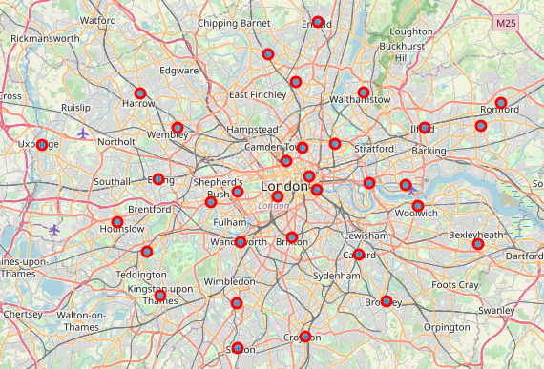
Borough of London

Slide 5
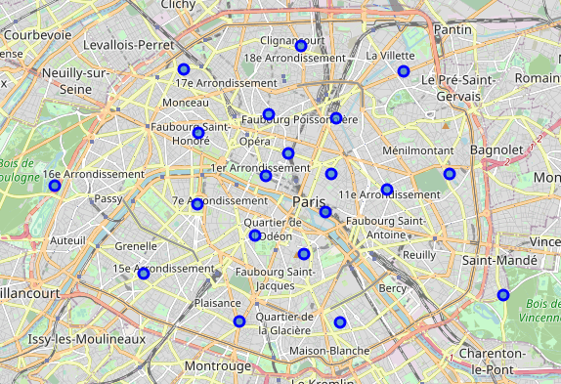
District of Paris

Slide 6
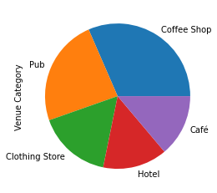
The top 5 venue in London

Slide 7
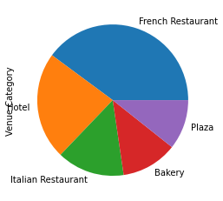
The top 5 venue in Paris

Slide 8
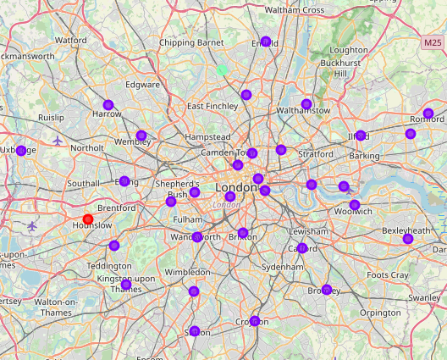
Clusters Map of London

Slide 9
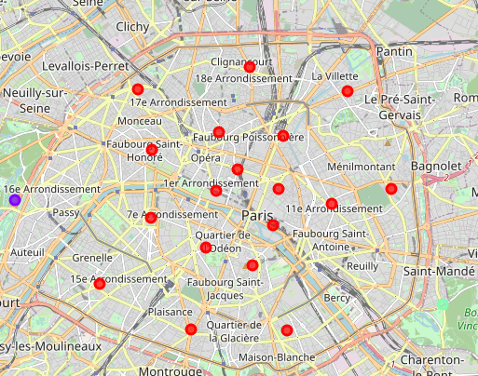
Clusters Map of Paris

Slide 10
Conclusion
As shown in the two cluster map of London and Paris, In fact most of the boroughs or districts in each city are quite similar with only some outliners that differ from the rest.
In London, Hounslow and Barnet are the outliner. In Paris, Passy and Reuilly are the outliner

